Slide 1


Spring Testing
Maksym Oleshchuk
Senior Software Engineer
July 28, 2017

Slide 2
CONTENTS
1
Spring Testing introduction (test pyramid)
2
Unit testing
3
Integration testing
4
JDBC Testing Support
5
MVC Test Framework

Slide 3
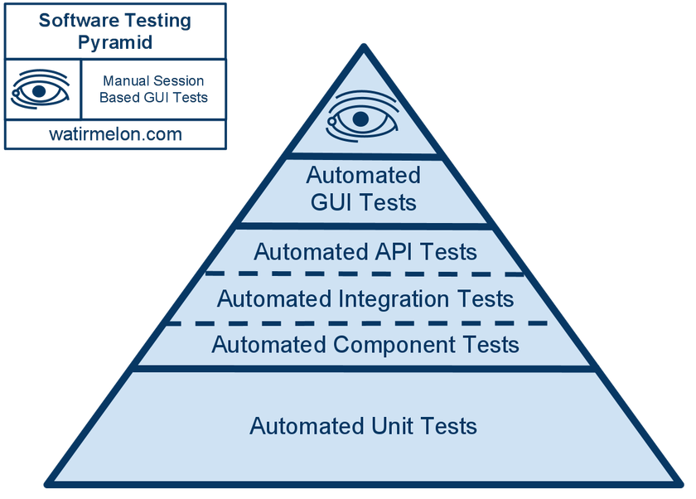
Testing pyramid

Slide 4
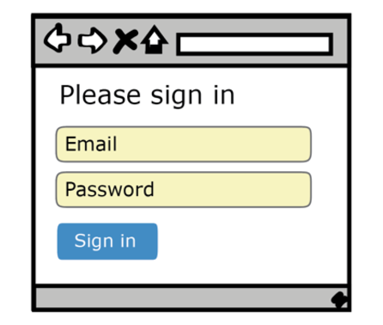
Testing pyramid example
Notes:
So here we have a humble login page. How would you go about writing an automated test for this.
Well if you take the point-of-view of an end user, you’d probably like to see a test that:
Visits the login page.
Enters a valid username and password.
Clicks the signin button, and then
Somehow verifies that we got redirected to the right page after.
Which is exactly what the User Interface Test does.

Slide 5
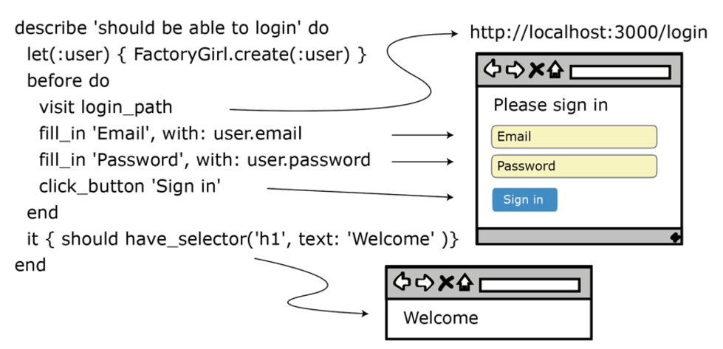
UI testing
Notes:
User Interface, or UI tests, are tests that test the system just like a real live end user would. They mimic the user’s interactions in the form or a script, we run that script in the form or a test, and it basically interacts with the system just like a regular user would.
For in this example here, written in RSpec, we visit the login page, fill in the user’s name and password, and then click the Sign in button just like a real user would.
It’s a beautiful, simple test, that tests the complete system end-to-end. That’s the UI test.

Slide 6
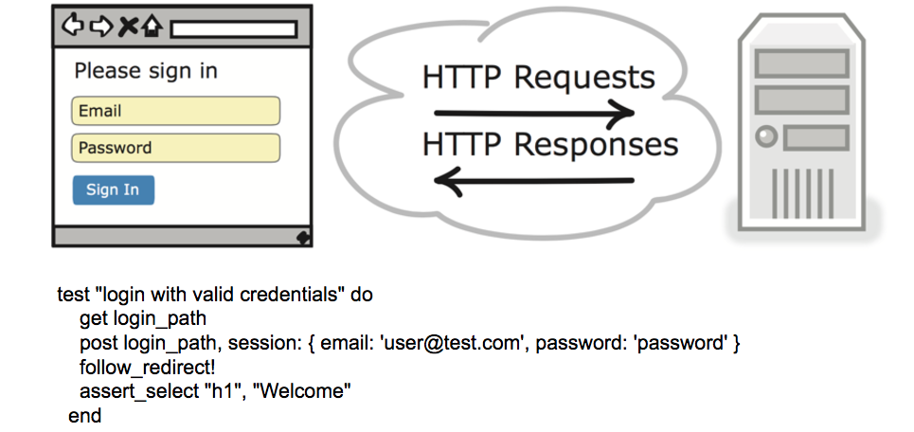
Integration testing
Notes:
Integrations tests, like UI tests, slice through various layers of the application, but in this case they don’t go through the UI. Here, in the case of this web application, the integration tests mimics the HTTP calls the browser would normally be making on behalf of the user as they were logging.
So, for example to visit the login page, an integration test would send an HTTP GET request to the web server with the address of the login page it wants to navigate to.
get login_path Then it send the username and password, the user would have normally entered, with something called an HTTP POST which would include the user’s credentials
post login_path, session: { email: ‘user@test.com’, ‘password: ‘password’ } It could then follow the successful login to the welcome a some welcome page, where it could then check and see that that it ended up in the right place. For example by looking an HTML header with the word ‘Welcome’.
Similar test to the UI test. Just testing the same functionality in a different way.
Now what about all the other things we could test when it comes to login pages. Things like field length, required fields, and checking for duplicate email addresses. We could write all those as UI and integration tests. But low level details like these are usually better served with faster, more precise type of test. Something we call a unit test.

Slide 7
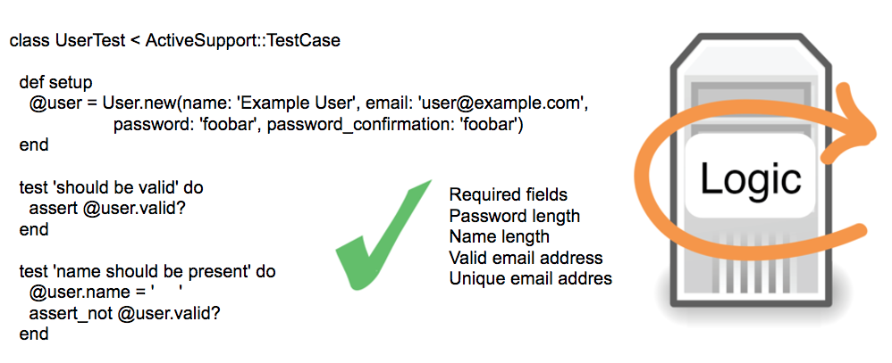
Unit testing
Notes:
Unit tests are tests developers write to prove to themselves, that the code they are writing works. In enables them to make changes, without fear of breaking everything. And they are really what enables teams to make changes to code aggressively.
So instead of going end-to-end through the various layers of the application like a UI or integration test would, unit test are much more local. These are low method levels tests developers write on objects. And they usually don’t hit other parts of the system.
Now the interesting question, is out of these three types of tests, how to do we when to choose one kind of test over the others?
So which is right?
You see we could have written all of the tests we just covered at each layer of the pyramid. They all would have worked. And teams that are new to automated testing sometimes go about doing that. Without understanding the trade-offs each kind of test has, they blindly duplicate these tests at each level of the pyramid. That leads to higher maintenance costs. Not to mention lots duplicated effort and waste.
This is where the testing pyramid comes in. It’s a way to talk about the various trade-offs we need to sometimes make between different kinds of tests, and gives us some rules of thumb around where and we to use. Take UI tests for example.

Slide 8
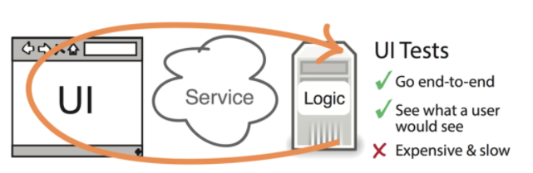
UI test pros and cons
Notes:
UI tests are fantastic and going end-to-end through the entire application, and ensuring that everything is hooked up and working. They are the deepest, most integrated kind of test we can write. And if an UI tests works, chances are very good everything is going to work in production.
But this awesomeness comes with a price. UI tests are very slow. It takes orders of magnitude longer to run a UI test than a unit test. Which means once we start to collect a lot of these things, our build times start to get long, our ability to iterate really slows down.
They are always very fragile. Changing the user interface often breaks the corresponding UI tests. So we have to be careful about how we write these things, and try really hard not to make them overly fragile.
So because of their speed and fragility, we tend to use UI tests more sparingly, and save them end-to-end style smoke tests.

Slide 9
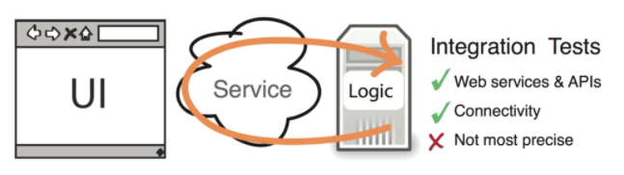
Integration test pros and cons
Notes:
Integration tests like UI tests also test connectivity. But because they don’t go through the UI, there are no where near as slow or fragile. These things are great and testing things like web services, and giving some level of confidence that things are things hooked up, without paying an exorbitant price.
And while they are good at telling us when we have a problem, they unfortunately they can’t really tell us precisely where. As it could be anywhere in the system.
For low level precision, that tell us exactly where things went wrong, we rely on the unit test.

Slide 10
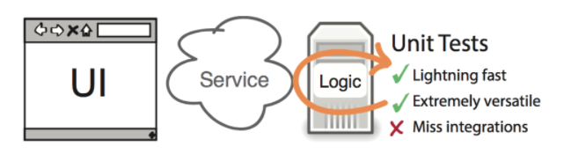
Unit test pros and cons
Notes:
Unit tests are the fastest, most productive form of automated test we’ve got. These tests are fast, efficient, highly precise, and can pinpoint exactly where something fails when a test breaks. They give really rapid feedback. Are inexpensive. And developers write hundreds of these things all day long with testing their applications.
They’re only downside is that unit tests do periodically miss bugs that can sometimes occur only when you hook things up. Which is why integration and UI tests are still valuable. But for the bulk of our automated testing efforts, we should be relying on the unit test.
And when you bring these three forms of test together, and you try to balance some of these trade-offs that we just talked about, that’s when you begin to appreciate the testing pyramid.

Slide 11
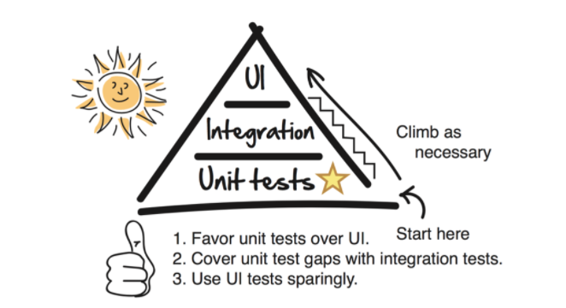
The Testing Pyramid
Notes:
The testing pyramid is a model that has become popular over the years because it visually captures some of the trade-offs we face when writing automated tests.
We may want to write everything as a UI test. But that would hurt, as our feedback and ability to iterate quickly would really slow down. So we tend to use UI tests more sparingly.
We know however that we are going to have integration bugs, so we do need some kind of test that enables us to test that various things are connected and hooked up. That’s why we have integration tests.
But usually, the fastest and cheapest test we can write is the unit test. Which is why we like to do the bulk of our automated testing down there. Where the tests are fast and cheap.
So that’s it! That’s the testing pyramid.
To learn more about the testing pyramid, and how to write really good UI, integration, and unit tests test, checkout my new book, The Way of the Web Tester---A beginners guide to the world of automated testing.

Slide 12
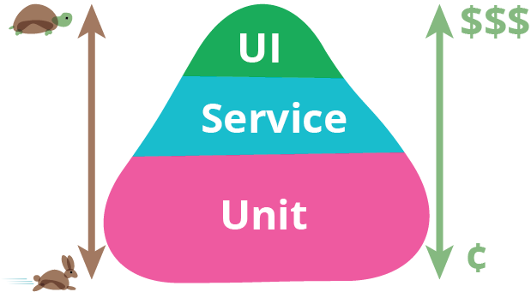
The Testing Pyramid

Slide 13
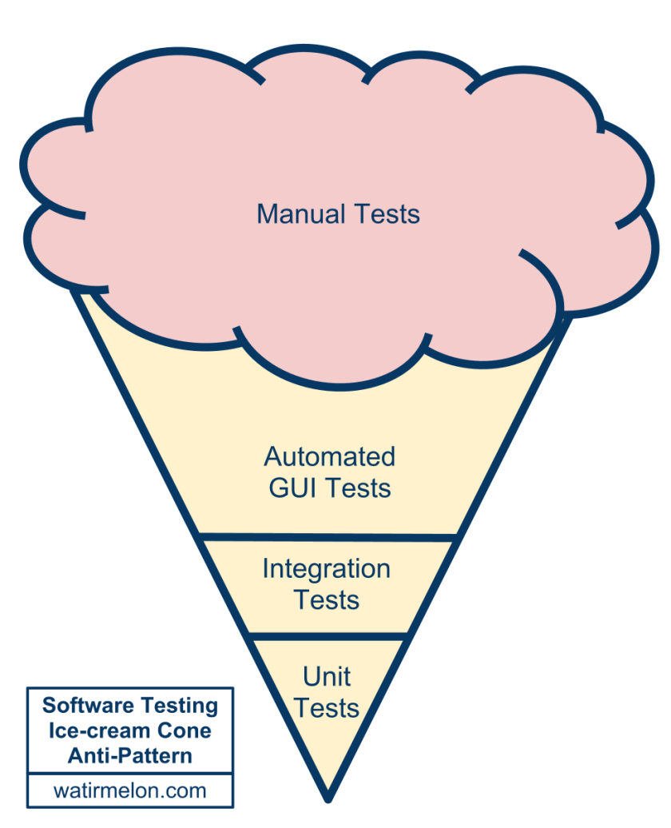
Ice-cream cone testing (anti-pattern)

Slide 14


Intro
Notes:
Testing is an integral part of enterprise software development. This chapter focuses on the value-add of the IoC principle to unit testing and on the benefits of the Spring Framework’s support for integration testing. (A thorough treatment of testing in the enterprise is beyond the scope of this reference manual.)

Slide 15

Unit testing

Slide 16


Unit testing
Notes:
Dependency Injection should make your code less dependent on the container than it would be with traditional Java EE development. The POJOs that make up your application should be testable in JUnit or TestNG tests, with objects simply instantiated using the new operator, without Spring or any other container. You can use mock objects (in conjunction with other valuable testing techniques) to test your code in isolation. If you follow the architecture recommendations for Spring, the resulting clean layering and componentization of your codebase will facilitate easier unit testing. For example, you can test service layer objects by stubbing or mocking DAO or Repository interfaces, without needing to access persistent data while running unit tests.
True unit tests typically run extremely quickly, as there is no runtime infrastructure to set up. Emphasizing true unit tests as part of your development methodology will boost your productivity. You may not need this section of the testing chapter to help you write effective unit tests for your IoC-based applications. For certain unit testing scenarios, however, the Spring Framework provides the following mock objects and testing support classes.

Slide 17
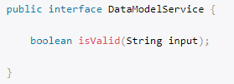
First example

Slide 18
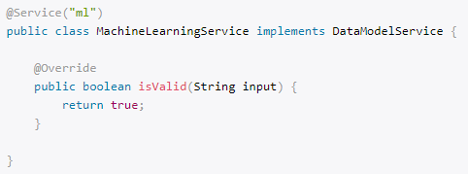
First example

Slide 19
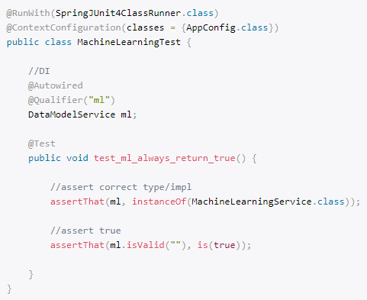
First example

Slide 20
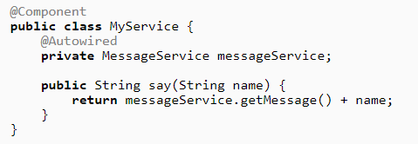
ReflectionTestUtils

Slide 21
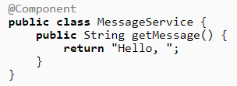
ReflectionTestUtils

Slide 22
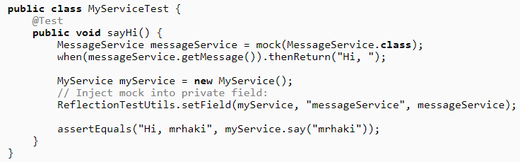
ReflectionTestUtils
Notes:
The org.springframework.test.util package contains several general purpose utilities for use in unit and integration testing.
ReflectionTestUtils is a collection of reflection-based utility methods. Developers use these methods in testing scenarios where they need to change the value of a constant, set a non-public field, invoke a non-public setter method, or invoke a non-public configuration or lifecycle callback method when testing application code involving use cases such as the following.
ORM frameworks such as JPA and Hibernate that condone private or protected field access as opposed to public setter methods for properties in a domain entity.
Spring’s support for annotations such as @Autowired, @Inject, and @Resource, which provides dependency injection for private or protected fields, setter methods, and configuration methods.
Use of annotations such as @PostConstruct and @PreDestroy for lifecycle callback methods.
AopTestUtils is a collection of AOP-related utility methods. These methods can be used to obtain a reference to the underlying target object hidden behind one or more Spring proxies. For example, if you have configured a bean as a dynamic mock using a library like EasyMock or Mockito and the mock is wrapped in a Spring proxy, you may need direct access to the underlying mock in order to configure expectations on it and perform verifications. For Spring’s core AOP utilities, see AopUtils and AopProxyUtils.

Slide 23

Integration testing
Notes:
It is important to be able to perform some integration testing without requiring deployment to your application server or connecting to other enterprise infrastructure. This will enable you to test things such as:
The correct wiring of your Spring IoC container contexts.
Data access using JDBC or an ORM tool. This would include such things as the correctness of SQL statements, Hibernate queries, JPA entity mappings, etc.
The Spring Framework provides first-class support for integration testing in the spring-test module. The name of the actual JAR file might include the release version and might also be in the long org.springframework.test form, depending on where you get it from (see the section on Dependency Management for an explanation). This library includes the org.springframework.test package, which contains valuable classes for integration testing with a Spring container. This testing does not rely on an application server or other deployment environment. Such tests are slower to run than unit tests but much faster than the equivalent Selenium tests or remote tests that rely on deployment to an application server.
In Spring 2.5 and later, unit and integration testing support is provided in the form of the annotation-driven Spring TestContext Framework. The TestContext framework is agnostic of the actual testing framework in use, thus allowing instrumentation of tests in various environments including JUnit, TestNG, and so on.

Slide 24
Integration testing goals
Manage Spring IoC container caching
Provide Dependency Injection of test fixture instances
Provide transaction management
Supply Spring-specific base classes
Notes:
Context management and caching
The Spring TestContext Framework provides consistent loading of Spring ApplicationContexts and WebApplicationContexts as well as caching of those contexts. Support for the caching of loaded contexts is important, because startup time can become an issue — not because of the overhead of Spring itself, but because the objects instantiated by the Spring container take time to instantiate. For example, a project with 50 to 100 Hibernate mapping files might take 10 to 20 seconds to load the mapping files, and incurring that cost before running every test in every test fixture leads to slower overall test runs that reduce developer productivity.
Dependency Injection of test fixtures
When the TestContext framework loads your application context, it can optionally configure instances of your test classes via Dependency Injection. This provides a convenient mechanism for setting up test fixtures using preconfigured beans from your application context. A strong benefit here is that you can reuse application contexts across various testing scenarios (e.g., for configuring Spring-managed object graphs, transactional proxies, DataSources, etc.), thus avoiding the need to duplicate complex test fixture setup for individual test cases.
15.2.3 Transaction management
One common issue in tests that access a real database is their effect on the state of the persistence store. Even when you’re using a development database, changes to the state may affect future tests. Also, many operations — such as inserting or modifying persistent data — cannot be performed (or verified) outside a transaction.
The TestContext framework addresses this issue. By default, the framework will create and roll back a transaction for each test. You simply write code that can assume the existence of a transaction. If you call transactionally proxied objects in your tests, they will behave correctly, according to their configured transactional semantics. In addition, if a test method deletes the contents of selected tables while running within the transaction managed for the test, the transaction will roll back by default, and the database will return to its state prior to execution of the test. Transactional support is provided to a test via a PlatformTransactionManager bean defined in the test’s application context.
Support classes for integration testing
The Spring TestContext Framework provides several abstract support classes that simplify the writing of integration tests. These base test classes provide well-defined hooks into the testing framework as well as convenient instance variables and methods, which enable you to access:
The ApplicationContext, for performing explicit bean lookups or testing the state of the context as a whole.
A JdbcTemplate, for executing SQL statements to query the database. Such queries can be used to confirm database state both prior to and after execution of database-related application code, and Spring ensures that such queries run in the scope of the same transaction as the application code. When used in conjunction with an ORM tool, be sure to avoid false positives.
In addition, you may want to create your own custom, application-wide superclass with instance variables and methods specific to your project.

Slide 25
@ContextConfiguration
Notes:
@ContextConfiguration defines class-level metadata that is used to determine how to load and configure an ApplicationContext for integration tests. Specifically,@ContextConfiguration declares the application context resource locations or the annotated classes that will be used to load the context.
Resource locations are typically XML configuration files or Groovy scripts located in the classpath; whereas, annotated classes are typically @Configuration classes. However, resource locations can also refer to files and scripts in the file system, and annotated classes can be component classes, etc.

Slide 26
@WebAppConfiguration
Notes:
@WebAppConfiguration is a class-level annotation that is used to declare that the ApplicationContext loaded for an integration test should be a WebApplicationContext. The mere presence of @WebAppConfiguration on a test class ensures that a WebApplicationContext will be loaded for the test, using the default value of "file:src/main/webapp" for the path to the root of the web application (i.e., the resource base path). The resource base path is used behind the scenes to create a MockServletContext which serves as the ServletContext for the test’s WebApplicationContext.
To override the default, specify a different base resource path via the implicit value attribute. Both classpath: and file: resource prefixes are supported. If no resource prefix is supplied the path is assumed to be a file system resource.
Note that @WebAppConfiguration must be used in conjunction with @ContextConfiguration, either within a single test class or within a test class hierarchy. See the @WebAppConfiguration javadocs for further details.

Slide 27
@ContextHierarchy
Notes:
@ContextHierarchy is a class-level annotation that is used to define a hierarchy of ApplicationContexts for integration tests. @ContextHierarchy should be declared with a list of one or more @ContextConfiguration instances, each of which defines a level in the context hierarchy. The following examples demonstrate the use of @ContextHierarchy within a single test class; however, @ContextHierarchy can also be used within a test class hierarchy.
If you need to merge or override the configuration for a given level of the context hierarchy within a test class hierarchy, you must explicitly name that level by supplying the same value to the name attribute in @ContextConfiguration at each corresponding level in the class hierarchy. See the section called “Context hierarchies” and the @ContextHierarchy javadocs for further examples.

Slide 28
@ActiveProfiles
Notes:
@ActiveProfiles is a class-level annotation that is used to declare which bean definition profiles should be active when loading an ApplicationContext for an integration test.
@ActiveProfiles provides support for inheriting active bean definition profiles declared by superclasses by default. It is also possible to resolve active bean definition profiles programmatically by implementing a custom ActiveProfilesResolver and registering it via the resolver attribute of @ActiveProfiles.

Slide 29
@TestPropertySource
Notes:
@TestPropertySource is a class-level annotation that is used to configure the locations of properties files and inlined properties to be added to the set of PropertySources in the Environment for an ApplicationContext loaded for an integration test.
Test property sources have higher precedence than those loaded from the operating system’s environment or Java system properties as well as property sources added by the application declaratively via @PropertySource or programmatically. Thus, test property sources can be used to selectively override properties defined in system and application property sources. Furthermore, inlined properties have higher precedence than properties loaded from resource locations.
The following example demonstrates how to declare a properties file from the classpath.
Default properties file detection
If @TestPropertySource is declared as an empty annotation (i.e., without explicit values for the locations or properties attributes), an attempt will be made to detect a default properties file relative to the class that declared the annotation. For example, if the annotated test class is com.example.MyTest, the corresponding default properties file is "classpath:com/example/MyTest.properties". If the default cannot be detected, an IllegalStateException will be thrown.

Slide 30
@DirtiesContext
Notes:
@DirtiesContext indicates that the underlying Spring ApplicationContext has been dirtied during the execution of a test (i.e., modified or corrupted in some manner — for example, by changing the state of a singleton bean) and should be closed. When an application context is marked dirty, it is removed from the testing framework’s cache and closed. As a consequence, the underlying Spring container will be rebuilt for any subsequent test that requires a context with the same configuration metadata.
@DirtiesContext can be used as both a class-level and method-level annotation within the same class or class hierarchy. In such scenarios, the ApplicationContext is marked as dirty before or after any such annotated method as well as before or after the current test class, depending on the configured methodMode and classMode.
The following examples explain when the context would be dirtied for various configuration scenarios:

Slide 31
@DirtiesContext
Notes:
@DirtiesContext indicates that the underlying Spring ApplicationContext has been dirtied during the execution of a test (i.e., modified or corrupted in some manner — for example, by changing the state of a singleton bean) and should be closed. When an application context is marked dirty, it is removed from the testing framework’s cache and closed. As a consequence, the underlying Spring container will be rebuilt for any subsequent test that requires a context with the same configuration metadata.
@DirtiesContext can be used as both a class-level and method-level annotation within the same class or class hierarchy. In such scenarios, the ApplicationContext is marked as dirty before or after any such annotated method as well as before or after the current test class, depending on the configured methodMode and classMode.
The following examples explain when the context would be dirtied for various configuration scenarios:

Slide 32
@DirtiesContext
Notes:
If @DirtiesContext is used in a test whose context is configured as part of a context hierarchy via @ContextHierarchy, the hierarchyMode flag can be used to control how the context cache is cleared. By default an exhaustive algorithm will be used that clears the context cache including not only the current level but also all other context hierarchies that share an ancestor context common to the current test; all ApplicationContexts that reside in a sub-hierarchy of the common ancestor context will be removed from the context cache and closed. If the exhaustive algorithm is overkill for a particular use case, the simpler current level algorithm can be specified instead, as seen below.

Slide 33
Standard Annotation Support
@Autowired
@Qualifier
@Resource (javax.annotation) if JSR-250 is present
@ManagedBean (javax.annotation) if JSR-250 is present
@Inject (javax.inject) if JSR-330 is present
@Named (javax.inject) if JSR-330 is present
@PersistenceContext (javax.persistence) if JPA is present
@PersistenceUnit (javax.persistence) if JPA is present
@Required
@Transactional
Notes:
@PostConstruct, before any before methods of the underlying test framework (e.g., methods annotated with JUnit 4’s @Before
@PreDestroy, that method will never be executed

Slide 34
Context configuration
Notes:
Each TestContext provides context management and caching support for the test instance it is responsible for. Test instances do not automatically receive access to the configured ApplicationContext. However, if a test class implements the ApplicationContextAware interface, a reference to the ApplicationContext is supplied to the test instance. Note that AbstractJUnit4SpringContextTests and AbstractTestNGSpringContextTests implement ApplicationContextAwareand therefore provide access to the ApplicationContext automatically.
Test classes that use the TestContext framework do not need to extend any particular class or implement a specific interface to configure their application context. Instead, configuration is achieved simply by declaring the @ContextConfiguration annotation at the class level. If your test class does not explicitly declare application context resource locations or annotated classes, the configured ContextLoader determines how to load a context from a default location or default configuration classes. In addition to context resource locations and annotated classes, an application context can also be configured via application context initializers.
The following sections explain how to configure an ApplicationContext via XML configuration files, Groovy scripts, annotated classes (typically @Configurationclasses), or context initializers using Spring’s @ContextConfiguration annotation. Alternatively, you can implement and configure your own custom SmartContextLoader for advanced use cases.

Slide 35
Context configuration inheritance
Notes:
@ContextConfiguration supports boolean inheritLocations and inheritInitializers attributes that denote whether resource locations or annotated classes and context initializers declared by superclasses should be inherited. The default value for both flags is true. This means that a test class inherits the resource locations or annotated classes as well as the context initializers declared by any superclasses. Specifically, the resource locations or annotated classes for a test class are appended to the list of resource locations or annotated classes declared by superclasses. Similarly, the initializers for a given test class will be added to the set of initializers defined by test superclasses. Thus, subclasses have the option of extending the resource locations, annotated classes, or context initializers.
If the inheritLocations or inheritInitializers attribute in @ContextConfiguration is set to false, the resource locations or annotated classes and the context initializers, respectively, for the test class shadow and effectively replace the configuration defined by superclasses.
In the following example that uses XML resource locations, the ApplicationContext for ExtendedTest will be loaded from "base-config.xml" and "extended-config.xml", in that order. Beans defined in "extended-config.xml" may therefore override (i.e., replace) those defined in "base-config.xml".

Slide 36
WebApplicationContext
Notes:
Spring 3.2 introduced support for loading a WebApplicationContext in integration tests. To instruct the TestContext framework to load a WebApplicationContextinstead of a standard ApplicationContext, simply annotate the respective test class with @WebAppConfiguration.
The presence of @WebAppConfiguration on your test class instructs the TestContext framework (TCF) that a WebApplicationContext (WAC) should be loaded for your integration tests. In the background the TCF makes sure that a MockServletContext is created and supplied to your test’s WAC. By default the base resource path for your MockServletContext will be set to "src/main/webapp". This is interpreted as a path relative to the root of your JVM (i.e., normally the path to your project). If you’re familiar with the directory structure of a web application in a Maven project, you’ll know that "src/main/webapp" is the default location for the root of your WAR. If you need to override this default, simply provide an alternate path to the @WebAppConfiguration annotation (e.g., @WebAppConfiguration("src/test/webapp")). If you wish to reference a base resource path from the classpath instead of the file system, just use Spring’s classpath: prefix.
Please note that Spring’s testing support for WebApplicationContexts is on par with its support for standard ApplicationContexts. When testing with a WebApplicationContext you are free to declare XML configuration files, Groovy scripts, or @Configuration classes via @ContextConfiguration. You are of course also free to use any other test annotations such as @ActiveProfiles, @TestExecutionListeners, @Sql, @Rollback, etc.
The following examples demonstrate some of the various configuration options for loading a WebApplicationContext.

Slide 37
WebApplicationContext

Slide 38
Transactions
Notes:
TransactionalTestExecutionListener

Slide 39
Executing SQL scripts
Notes:
Spring provides the following options for executing SQL scripts programmatically within integration test methods.
org.springframework.jdbc.datasource.init.ScriptUtils
org.springframework.jdbc.datasource.init.ResourceDatabasePopulator
org.springframework.test.context.junit4.AbstractTransactionalJUnit4SpringContextTests
org.springframework.test.context.testng.AbstractTransactionalTestNGSpringContextTests
ScriptUtils provides a collection of static utility methods for working with SQL scripts and is mainly intended for internal use within the framework. However, if you require full control over how SQL scripts are parsed and executed, ScriptUtils may suit your needs better than some of the other alternatives described below. Consult the javadocs for individual methods in ScriptUtils for further details.
ResourceDatabasePopulator provides a simple object-based API for programmatically populating, initializing, or cleaning up a database using SQL scripts defined in external resources. ResourceDatabasePopulator provides options for configuring the character encoding, statement separator, comment delimiters, and error handling flags used when parsing and executing the scripts, and each of the configuration options has a reasonable default value. Consult the javadocs for details on default values. To execute the scripts configured in a ResourceDatabasePopulator, you can invoke either the populate(Connection) method to execute the populator against a java.sql.Connection or the execute(DataSource) method to execute the populator against a javax.sql.DataSource. The following example specifies SQL scripts for a test schema and test data, sets the statement separator to "@@", and then executes the scripts against a DataSource.

Slide 40
Executing SQL scripts
Notes:
In addition to the aforementioned mechanisms for executing SQL scripts programmatically, SQL scripts can also be configured declaratively in the Spring TestContext Framework. Specifically, the @Sql annotation can be declared on a test class or test method to configure the resource paths to SQL scripts that should be executed against a given database either before or after an integration test method. Note that method-level declarations override class-level declarations and that support for@Sql is provided by the SqlScriptsTestExecutionListener which is enabled by default.
Path resource semantics
Each path will be interpreted as a Spring Resource. A plain path — for example, "schema.sql" — will be treated as a classpath resource that is relative to the package in which the test class is defined. A path starting with a slash will be treated as an absolute classpath resource, for example: "/org/example/schema.sql". A path which references a URL (e.g., a path prefixed with classpath:, file:, http:, etc.) will be loaded using the specified resource protocol.
The following example demonstrates how to use @Sql at the class level and at the method level within a JUnit 4 based integration test class.

Slide 41
Spring MVC Test Framework
Notes:
The Spring MVC Test framework provides first class support for testing Spring MVC code using a fluent API that can be used with JUnit, TestNG, or any other testing framework. It’s built on the Servlet API mock objects from the spring-test module and hence does not use a running Servlet container. It uses the DispatcherServlet to provide full Spring MVC runtime behavior and provides support for loading actual Spring configuration with the TestContext framework in addition to a standalone mode in which controllers may be instantiated manually and tested one at a time.
Spring MVC Test also provides client-side support for testing code that uses the RestTemplate. Client-side tests mock the server responses and also do not use a running server.
It’s easy to write a plain unit test for a Spring MVC controller using JUnit or TestNG: simply instantiate the controller, inject it with mocked or stubbed dependencies, and call its methods passing MockHttpServletRequest, MockHttpServletResponse, etc., as necessary. However, when writing such a unit test, much remains untested: for example, request mappings, data binding, type conversion, validation, and much more. Furthermore, other controller methods such as @InitBinder, @ModelAttribute, and @ExceptionHandler may also be invoked as part of the request processing lifecycle.
The goal of Spring MVC Test is to provide an effective way for testing controllers by performing requests and generating responses through the actual DispatcherServlet.
Spring MVC Test builds on the familiar "mock" implementations of the Servlet API available in the spring-test module. This allows performing requests and generating responses without the need for running in a Servlet container. For the most part everything should work as it does at runtime with a few notable exceptions as explained in the section called “Differences between Out-of-Container and End-to-End Integration Tests”. Here is a JUnit 4 based example of using Spring MVC Test:
The above test relies on the WebApplicationContext support of the TestContext framework for loading Spring configuration from an XML configuration file located in the same package as the test class, but Java-based and Groovy-based configuration are also supported. See these sample tests.
The MockMvc instance is used to perform a GET request to "/accounts/1" and verify that the resulting response has status 200, the content type is "application/json", and the response body has a JSON property called "name" with the value "Lee". The jsonPath syntax is supported through the Jayway JsonPath project. There are lots of other options for verifying the result of the performed request that will be discussed below.

Slide 42
Performing request

Slide 43
Expectations
Notes:
Expectations can be defined by appending one or more .andExpect(..) calls after performing a request:
MockMvcResultMatchers.* provides a number of expectations, some of which are further nested with more detailed expectations.
Expectations fall in two general categories. The first category of assertions verifies properties of the response: for example, the response status, headers, and content. These are the most important results to assert.
The second category of assertions goes beyond the response. These assertions allow one to inspect Spring MVC specific aspects such as which controller method processed the request, whether an exception was raised and handled, what the content of the model is, what view was selected, what flash attributes were added, and so on. They also allow one to inspect Servlet specific aspects such as request and session attributes.
The following test asserts that binding or validation failed:
Many times when writing tests, it’s useful to dump the results of the performed request. This can be done as follows, where print() is a static import fromMockMvcResultHandlers:
As long as request processing does not cause an unhandled exception, the print() method will print all the available result data to System.out. Spring Framework 4.2 introduced a log() method and two additional variants of the print() method, one that accepts an OutputStream and one that accepts a Writer. For example, invoking print(System.err) will print the result data to System.err; while invoking print(myWriter) will print the result data to a custom writer. If you would like to have the result data logged instead of printed, simply invoke the log() method which will log the result data as a single DEBUG message under theorg.springframework.test.web.servlet.result logging category.
In some cases, you may want to get direct access to the result and verify something that cannot be verified otherwise. This can be achieved by appending .andReturn() after all other expectations:

Slide 44
Mock MVC example

Slide 45
Mock MVC example

Slide 46
QUESTIONS

